Slide 1
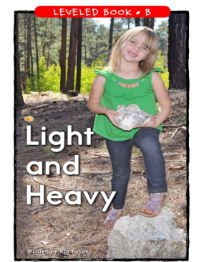

Slide 2
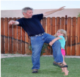
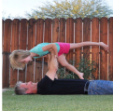


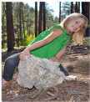

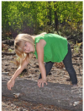
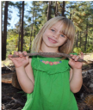
Click to see what things are heavy or light.

Slide 3
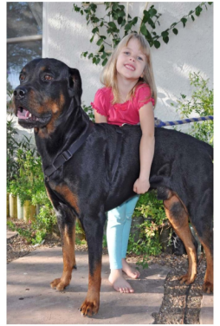
This dog is light.
I can lift it.
return

Slide 4
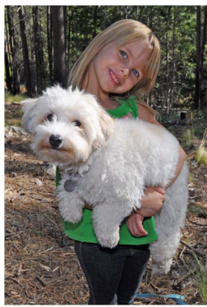
This dog is heavy.
I cannot lift it.
return

Slide 5
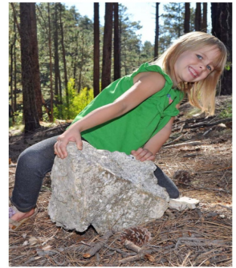
This rock is heavy.
I cannot lift it.
return

Slide 6
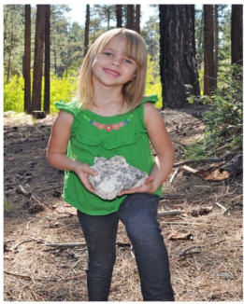
This rock is light.
I can lift it.
return

Slide 7
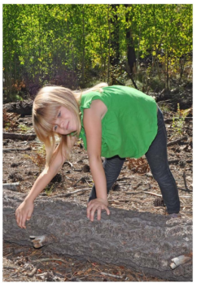
This log is heavy.
I cannot lift it.
return

Slide 8
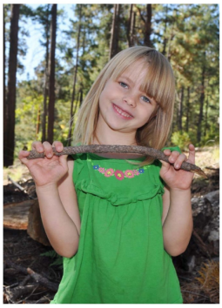
This stick is heavy.
I can lift it.
return

Slide 9
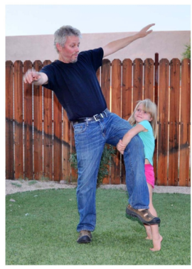
Dad is heavy.
I cannot lift him.
return

Slide 10
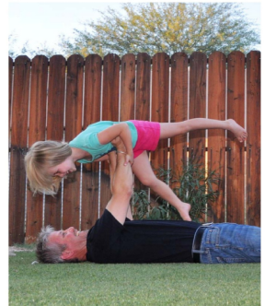
I am light.
Dad can lift me!.
return

